Slide 1
Human Reproduction
♀ ♂

Slide 2
Female Reproductive System
Female reproductive organs are for
intercourse, reproduction, urination
pregnancy and childbirth.

Slide 3
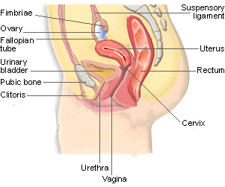

Internal Female Anatomy— click on button for
more information
Click here when completely finished

Slide 4
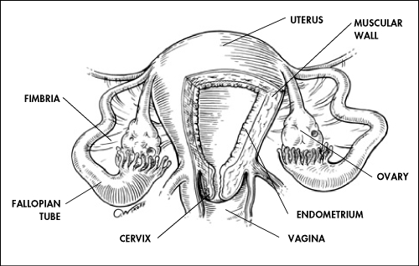
Front View
Click here

Slide 5
Ovary (Ovaries)
Two solid egg-shaped structures
They are attached to the uterus by ligaments. They are the counterpart of the male testicles.
Ovaries have two main functions:
#1-store and release the ova or female egg cell. Some of the ova disappear; others are dormant until each is ripened and released after puberty.
  #2-produce female sex hormones ESTROGEN and PROGESTERONE
Click here

Slide 6
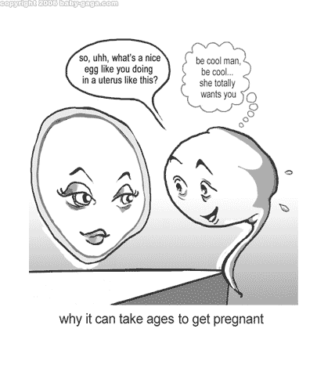
Ova
The female reproductive cell.
They are the largest cells in the female body. (about the size of a grain of sand.)
The female baby is born with all the ova she will ever have (about 200,000 in each ovary).
About 400-500 ova mature and are released over a lifetime
Click here

Slide 7
Estrogen
Estrogen is responsible for the secondary sex characteristics and the sex drive in females. It spurs the onset of puberty and is responsible for OVULATION.
Click here

Slide 8
Progesterone
Progesterone builds up the lining of the uterus called the endometrium in preparation for the fertilized ovum
Click here

Slide 9
Ovulation
When the egg is released from the ovary.
At the age of puberty
The ovum moves to the surface of the ovary in bursts out
The ova falls into the fallopian tube and waits for fertilization
This happens every 28 days
It happens at about the 14th day of the cycle
Click here

Slide 10
FALLOPIAN TUBES
(oviducts)
Two tubes attached on either side of the uterus.
They are about four inches long and 3/16 inch in diameter (the size of a cooked spaghetti noodle).
The oviducts carry egg cells toward the uterus and sperm cells toward the egg cell.
Fertilization takes place in the upper third of the oviduct.
Click here

Slide 11
Uterus
A hollow, muscular organ (shaped somewhat like an upside-down pear, about the size of a fist).
The uterus is lined with endometrium (a blood lining.)
The uterus has one main function—to protect and nourish a fetus
The walls of the uterus have the ability to stretch to the size of a small watermelon.
After childbirth the uterus shrinks back to the original shape in 6-8 weeks, but it can take up to nine months for the uterus to fully recover.
Click here

Slide 12
Cervix
The neck or opening of the uterus.
A normal healthy cervix is the strongest muscle in the body.
It dips down about half an inch into the vagina.
It is normally plugged by mucus. It stays tightly closed during pregnancy, but thins and opens for the delivery of the baby.
How big does it need to dilate to for birth?
Click here

Slide 13
Vagina
Female organ used for intercourse, it is an empty passageway leading from the vaginal opening to the uterus.
It is only 3-4 inches long, but will lengthen during arousal.
The vaginal walls are made of many small folds of membrane that stretch greatly to accommodate a baby during birth.
The vaginal wall also secrete a fluid that helps to make intercourse easier.
Click here

Slide 14
Urethra
The opening to the bladder
Click here

Slide 15
Clitoris
A small, pea shaped bump at the front of the labia.
It contains a small amount of erectile tissue.
The clitoris increases sexual pleasure
Click here

Slide 16
Woman’s Cycle
Day 1 – Menstruation begins (bleeding)
Day 5 – Menstruation is usually ended
Day 14 – Ovum has matured and bursts out of
the ovary
Day 15 – After 24 hours the egg is done
Day 26 – In the absence of fertilization,
estrogen/progesterone levels drop
and the endometrium lining breads
down
Day 28 – Menstruation begins again.
Click here

Slide 17
TIME LINE:
Ages 9-12
  Secondary sex characteristics appear
Ages 11-14
  Menstrual cycle begins
Late 20-30's
  Peak sexual urges
Ages 45-55
  Menopause (cycle stops, but sex urge continues)
Click here

Slide 18
Male Reproductive System
Male reproductive organs are for intercourse, reproduction and urination

Slide 19
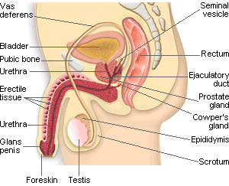
Male Anatomy Click on a button for more information
Click here when completely finished

Slide 20
Scrotum
A sac-like pouch located behind the penis that holds each testes and helps regulate temperature for sperm production.
Click here

Slide 21
Testicles or Testes
The two testes are small organs that lie in the scrotum and produce sperm and the male hormone testosterone.
The testicles are outside the body because the male sperm that is manufactured in the testes need cooler-than-body temperature for normal growth and development.
Loss of one does not impair the function of the other.
Four to five billion sperm cells are produced each month.
Click here

Slide 22
Testoterone
the male reproductive hormone made by the testicles which causes the changes of puberty.
This hormone causes secondary sex characteristics, production of sperm and sexual urge.
It is produced in the testicles and enters the bloodstream at a fairly constant rate.
Click here

Slide 23
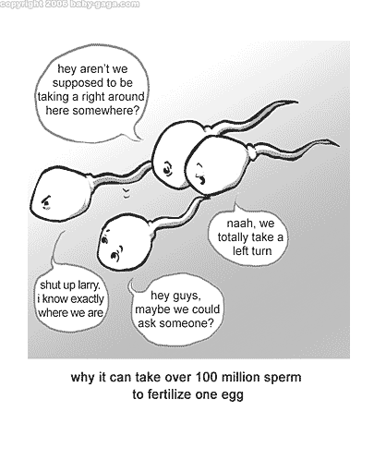
Sperm
The microscopic cells produced by the male's testicles which can fertilize the female's ovum.
They are tiny, living cells 100 times smaller than a pencil dot. (the smallest cell in a mans body
Enough sperm would fit on the head of a pin to re-populate the earth if each sperm fertilized an egg.
It is destroyed by warm body temperature, acidic environment.
It can survive in a women’s body for 5-8 days.
Any sperm not ejaculated are passed in the urine.
Click here

Slide 24
Epididymis
the structure that forms a mass over the back and upper part of each testes.
Sperm are stored there for as long as six weeks while they ripen to maturity.
Click here

Slide 25
Cowpers Gland
two small pea-sized glands located beneath the prostate gland on both sides of the base of the penis.
They secrete a clear, sticky fluid that helps to neutralize the acidity of the urethra.
Click here

Slide 26
Vas Deferens
two long, thin tubes that serve as a passageway for sperm and a place for sperm storage.
The contraction of the vas deferens along with the action of the cilia help transport the sperm through the vas deferens.
Click here

Slide 27
Seminal Vesicles
two small glands that secrete a fluid that nourishes and enables the sperm to move.
Click here

Slide 28
Prostate Gland
surround the urethra beneath the bladder. The gland secretes an alkaline fluid that neutralizes the acid found in the male urethra and the female reproductive tract.
Without the action of the secretions of the prostate gland, many sperm would die and fertilization of an ovum would be impossible.
Click here

Slide 29
Urethra
A dual purpose tube that both semen and urine pass through to leave the body. Semen and urine never mix.
Special muscles or sphincters surround the urethra.
During urination, one sphincter will relax so that the pressure from the bladder will push urine out from the body.
During ejaculation, another sphincter will relax so that semen can flow through the urethra to the outside of the body.
Click here

Slide 30
Penis
The male organ for sexual intercourse, reproduction, and urination.
The reproductive purpose of the penis is to deposit semen in the vagina during sexual intercourse.
The head of the penis or glans contains many nerve endings. At birth the glans is covered by a loosely fitting skin called the foreskin.
When the penis is erect it is 5-7 inches long An erection occurs when the sponge-like chambers in the penis fill with blood.
Click here

Slide 31
SEMEN:
a combination of fluid that is produced in the seminal vesicles, prostate gland, and Cowper's gland. This fluid nourishes and helps sperm move through the urethra.
Click here

Slide 32
EJACULATION
the passage of sperm from the penis, a result of a series of muscular contractions.
Click here

Slide 33
TIME LINE:
Infancy
  Erections begin
Ages 11-14
  Secondary sex characteristics appear
Ages 13-16
  Sperm produced in adult amounts (puberty)
Late teens
  Peak sexual urges for boys
Throughout life
  If good health is present, there is the sex urge and ability to father children

